Slide 1
Development Processes and Organizations
Teaching materials to accompany:
Product Design and Development
Chapter 2
Karl T. Ulrich and Steven D. Eppinger
5th Edition, Irwin McGraw-Hill, 2012.

Slide 2
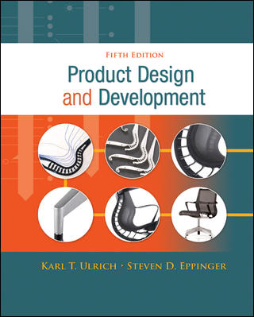
Product Design and Development
Karl T. Ulrich and Steven D. Eppinger
5th edition, Irwin McGraw-Hill, 2012.
Chapter Table of Contents:
Introduction
Development Processes and Organizations
Opportunity Identification
Product Planning
Identifying Customer Needs
Product Specifications
Concept Generation
Concept Selection
Concept Testing
Product Architecture
Industrial Design
Design for Environment
Design for Manufacturing
Prototyping
Robust Design
Patents and Intellectual Property
Product Development Economics
Managing Projects

Slide 3
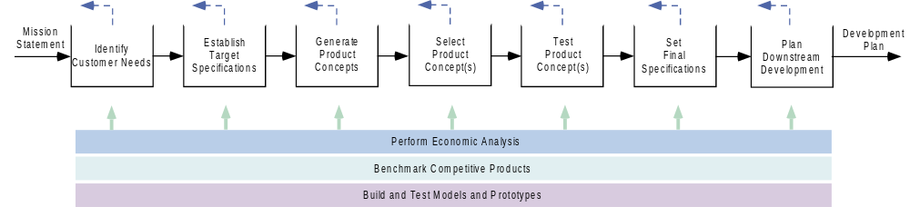
Concept Development Process

Slide 4
Generic Product Development Process
Planning
Concept
Development
System-Level
Design
Detail
Design
Testing and
Refinement
Production
Ramp-Up
Mission
Approval
Concept
Review
System Spec
Review
Critical Design
Review
Production
Approval

Slide 5
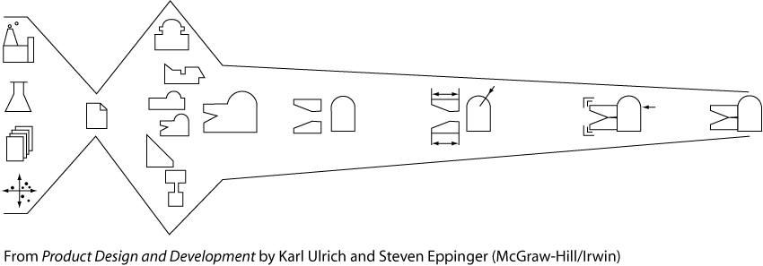

Slide 6
Core development stages
Solution approach
Concept design
Architectural design
Detailed design
Process design
Fabrication and assembly
Test and deployment

Slide 7
Solution Approach
Concept for solutions
DFX

Slide 8
Concept development
A description of the form, function, and features of a product
A set of specifications
An economic justification of the project.

Slide 9
System (architectural) design
Definition of product architecture, with an assembly layout.
Division of the product into subsystems and components, each with a functional specification.

Slide 10
Detailed design
Complete specification of the geometry, materials, and tolerances of each of the unique parts
Identification of all standard parts to be purchased.
Establishment of a process plan and tooling

Slide 11
Test and refinement
Construction and evaluation of multiple pre-production versions of the product.
Early (alpha) prototypes are usually built with production-intent parts (but may not be with the intended production processes) for testing in the designer's environment, if the design intent and key customer needs are met.
Later (beta) prototypes are built with parts supplied by the intended production processes (but may not be with the intended-assembly process), tested by customers in their environment, and to evaluate product performance and reliability.

Slide 12
Production ramp-up
The product is made using the intended production system.
To train the work force and to work out any remaining problems in the production processes.

Slide 13
A generic concept development process
Identifying customer needs
Establishing target specifications
Concept generation
Concept selection
Concept testing
Setting final specifications
Project planning
Economic analysis
Benchmarking of competitive products
Modeling and prototyping

Slide 14
Rapid Iteration PD Process
Many Iteration Cycles
Planning
Concept
Development
System-Level
Design
Design
Build
Test
Production
Ramp-Up
Mission
Approval
Concept
Review
Cycle Plan
Review
Cycle
Review

Slide 15
Complex System PD Process
Design
Test
Design
Test
Planning
Concept
Development
System-Level
Design
Integrate
and Test
Validation
and Ramp-Up
Design
Test
Mission
Approval
Concept
Review
System
Review
Production
Approval
Design
Test

Slide 16
Concept Development Process
Mission
Statement
Development
Plan
Identify
Customer
Needs
Establish
Target
Specifications
Generate
Product
Concepts
Select
Product
Concept(s)
Test
Product
Concept(s)
Set
Final
Specifications
Plan
Downstream
Development
Perform Economic Analysis
Benchmark Competitive Products
Build and Test Models and Prototypes
Front-end of PD need not be a fuzzy process.
Structured methods exist for each process step (see text chapters 4 to 8).
This is not strictly sequential -- generally a parallel and iterative process.

Slide 17








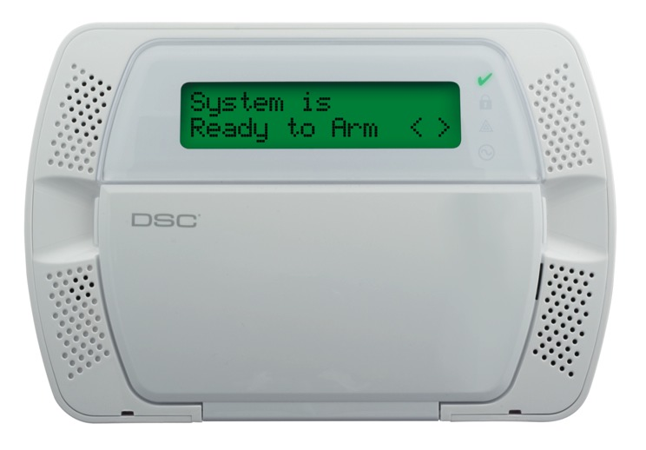
Tyco Product Development Process
Project
Registration
Concept
Definition
Feasibility
and Planning
Preliminary
Design
Final
Design
Product
Verification
Process
Verification
Launch
Post-Launch
Assessment
RP
0
RP
1
RP
2
RP
3
RP
4
RP
5
RP
6
RP
7
RP
8

Slide 18
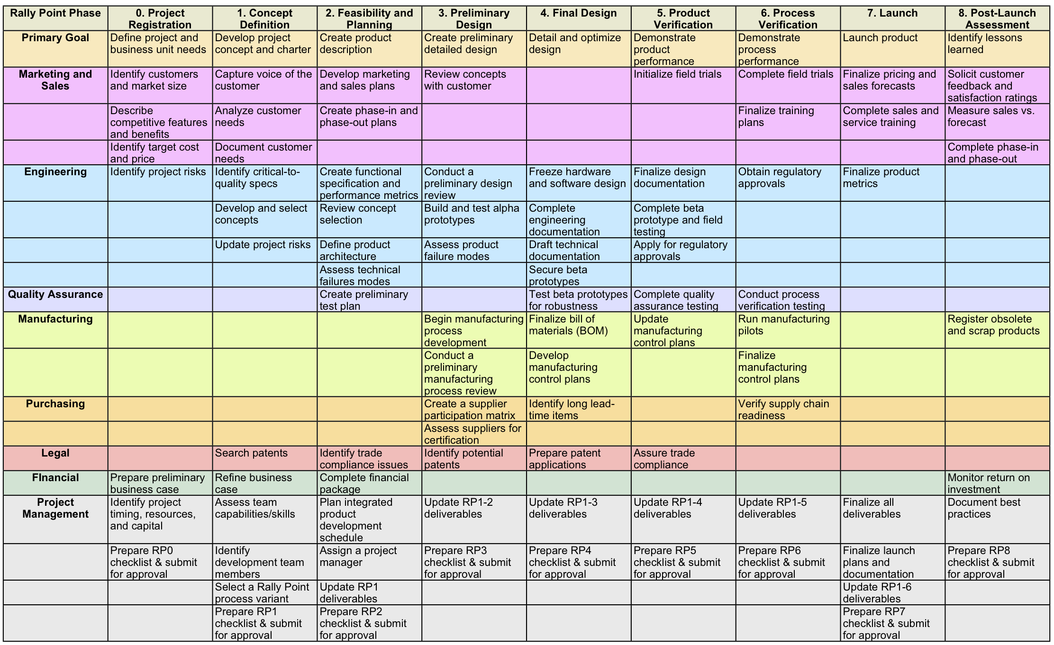
Tyco Product Development Process

Slide 19
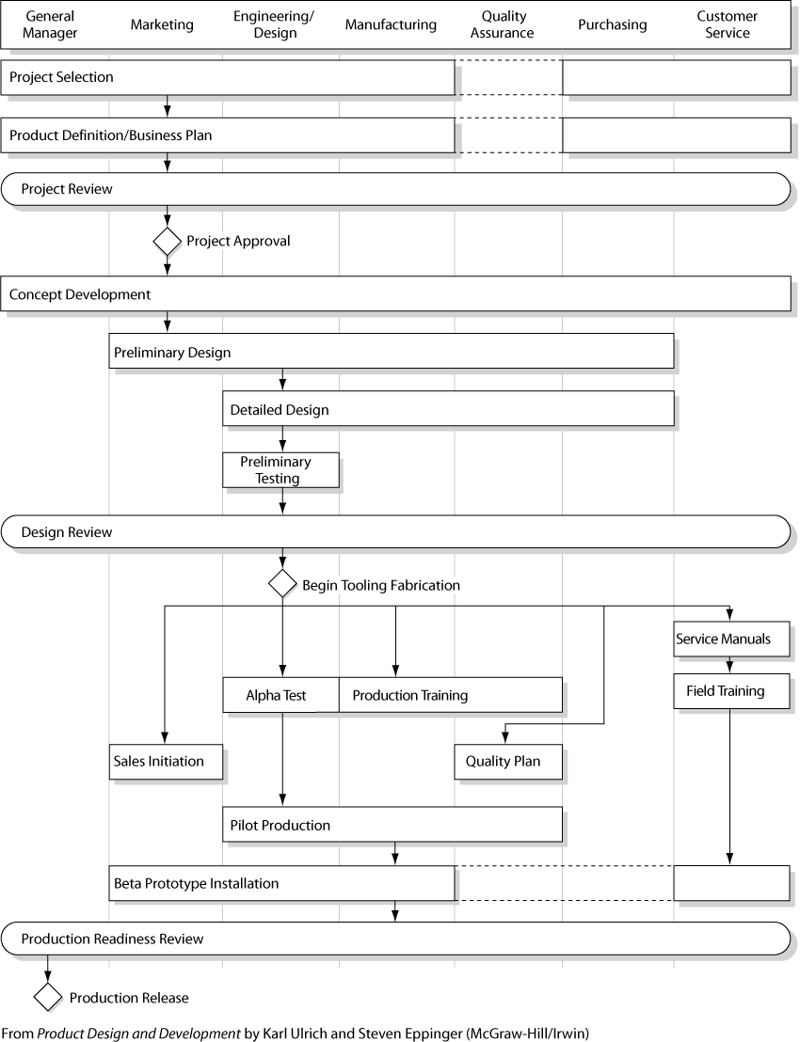

Slide 20
Organizational types
Strict functional organization
Strict project organization
Matrix organization

Slide 21
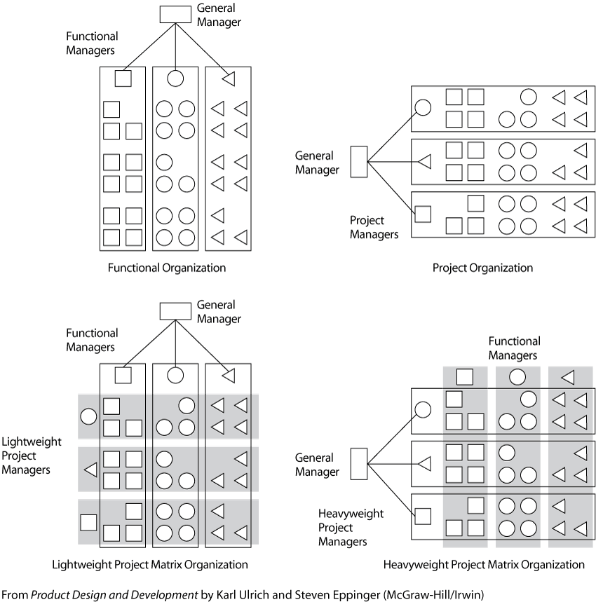

Slide 22
Matrix organization
A hybrid of functional and project organizations
Each individual is linked to others according to both the project they work on and their functions
Each has two supervisors: project manager and functional manager.
Two variants of the matrix organizations
  Heavyweight project organization (i.e., strong project links).
  Lightweight project organization (strong functional links).

Slide 23
Factors for affecting an org. structure
Importance of cross-functional integration
Criticalness of cutting-edge functional expertise to business success
Utilization of resources from each function
Importance of product development speed

Slide 24
Organizational linkages
• Reporting relationship
• Financial arrangement
• Physical layout.

Slide 25
Other Images

Slide 26
Variants of the development process
Market pull products
Technology push products
Platform products
Process-intensive products
Customized products
high-risk product
Quick build products
Complex systems

Slide 27
Variants
Market-pull products
  The firm finds a market opportunity and a technology to meet customer's needs. Thermo care.
Technology-push products
  The firm begins with a new technology and then finds a market for it. Glue for “post-it.”
Platform products
  Use of a proven technology platform to build a new product. Instant film used in Polaroid cameras.
Process-intensive products
  Develop product and process simultaneously.

Slide 28
Variants
Customized products
  Build a new product by varying existing configurations.
High-risk products
  Intensive and early test and analysis
Quick-build products
  Rapid modeling & prototyping at testing phase
Complex systems
  Subsystems and integration worked by teams

Slide 29
Traditional design methods
Aggregation
  (include new functions)
Adaptation
  (adapt to new conditions)
Application
  (apply a proven technology to a new area)
analysis of properties
  (thorough analysis of an existing design to improve)
Brainstorming
  (find many solutions to a problem)

Slide 30
Traditional design methods
systematic search of field
  (obtain complete possible information)
Questioning
  (apply a system of questions to produce mental simulation)
mental experiment
  (observe an idealized mental model at work)
value analysis
Evaluation
  (find best variant among a few by point-counting)

Slide 31
Traditional design methods
invention
Iteration
  (to solve a system with complicated interactions)
experimentation
division of totality
math & computer modeling

Slide 32
Chapter 2: Home work
Exercise (Analysis of Properties)
Focus on materials selection for an existing product
Steps:
1. Examine each component of a product (an incandescent bulb, stapler, can opener).
2. Break the product or decompose it, avoiding injury to eyes or hands and damage to the other components.
3. Construct and complete a table consisting the following items on its columns.
  a. list each component of the product
  b. define the function of each component
  c. identify the material used
  d. reason why it was selected
  e. select possible alternative.
4. List five failure mechanisms

